Slide 1
Floating
LESSON 5

Slide 2
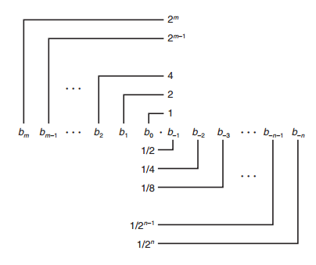
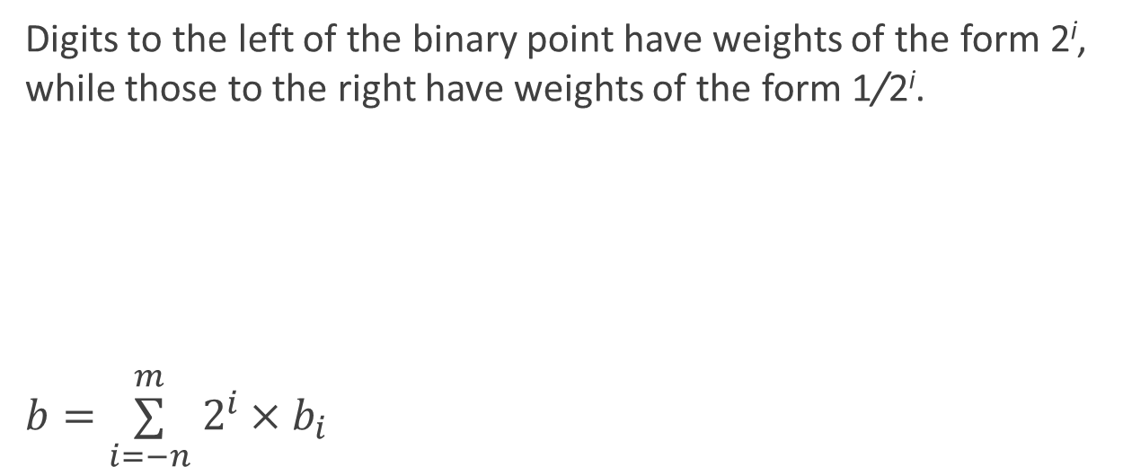
Fractional Binary Representation
Digits to the left of the binary point have weights of the form 2^{i}, while those to the right have weights of the form 1/2^{i}.
$b=\overset{m}{\underset{i=−n}{∑}} 2^{i}×b_{i}$

Slide 3

Fractional Binary Numbers: Examples
Value Representation
$5 \frac{3}{4}$ 101.11₂
$2 \frac{7}{8}$ 010.111₂
$1 \frac{7}{16}$ 001.0111₂
Observations
Divide by 2 by shifting right(unsigned)
Multiply by 2 by shifting left
Numbers of form 0.11111……₂ are just below 1.0
1/2 + 1/4 + 1/8 + …… 1/2^{i} → 1.0
Use notation 1.0 - ε

Slide 4
Representable Numbers
Limitation #1
Can only exactly represent numbers of the form x/2^{k}
Other rational numbers have repeating bit representations
Value Representation
1/3 0.0101010101[01]…₂
1/5 0.001100110011[0011]…₂
1/10 0.0001100110011[0011]…₂
Limitation #2
Just one setting of decimal point within the w bits
Limited range of numbers (very small values? very large?)

Slide 5

Encoding Rational Numbers（有理数）
Form $v=x×2^{y}$
Very useful when $\left|v\right|≫0$ or $\left|v\right|≪1$
An Approximation to real arithmetic
From programmer’s perspective
Uninteresting
Arcane （神秘的）and incomprehensive （难以理解的）
Notes:
对于表示非常大的数字，非常接近0的数字，以及作为实数运算的近似值非常有用。

Slide 6
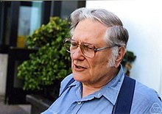
History & Features
Until 1980s
Many idiosyncratic （特殊的） formats
IEEE Standard 754
Established in 1985 as uniform standard for floating point arithmetic
Designed by W. Kahan for Intel processors
Supported by all major CPUs
Driven by numerical concerns
Nice standards for rounding, overflow, underflow
Try hard to make fast in hardware
Numerical analysts predominated over hardware designers in defining standard
Notes:
fast speed, easy implementation, less accuracy

Slide 7
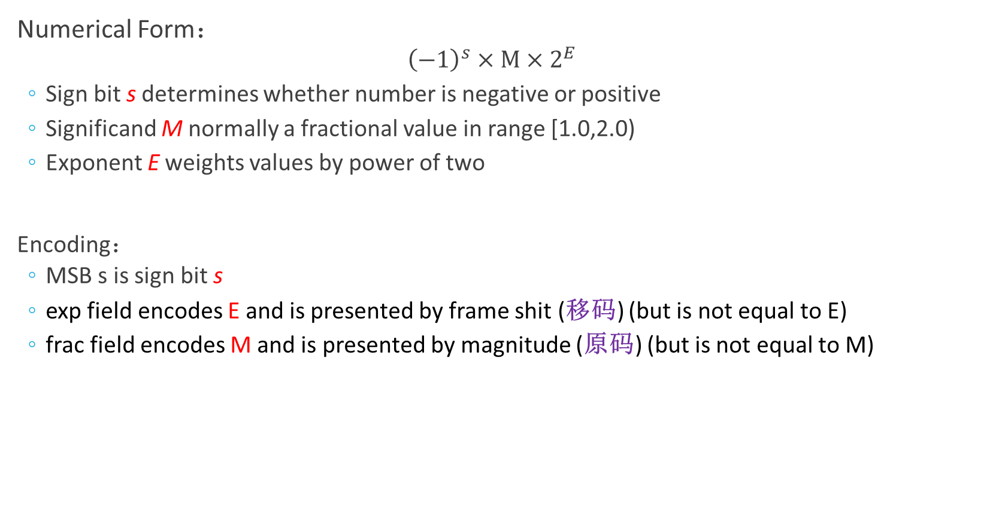
Floating Point Representation
Numerical Form：
$${\left(−1\right)}^{s}×M×2^{E}$$
Sign bit s determines whether number is negative or positive
Significand M normally a fractional value in range [1.0,2.0)
Exponent E weights values by power of two
Encoding：
MSB s is sign bit s
exp field encodes E and is presented by frame shit (移码) (but is not equal to E)
frac field encodes M and is presented by magnitude (原码) (but is not equal to M)
Notes:
Significand 尾数
Exponent 阶码，2E表示浮点数的阶，E为阶码

Slide 8


Precision options
Single precision: 32 bits
Double precision: 64 bits
Extended precision: 80 bits (Intel only)
Notes:
给定浮点数编码格式后，根据exp的值，浮点数取值有三种不同的情况：规格化的值、非规格化的值以及特殊值（无穷大或非数）

Slide 9
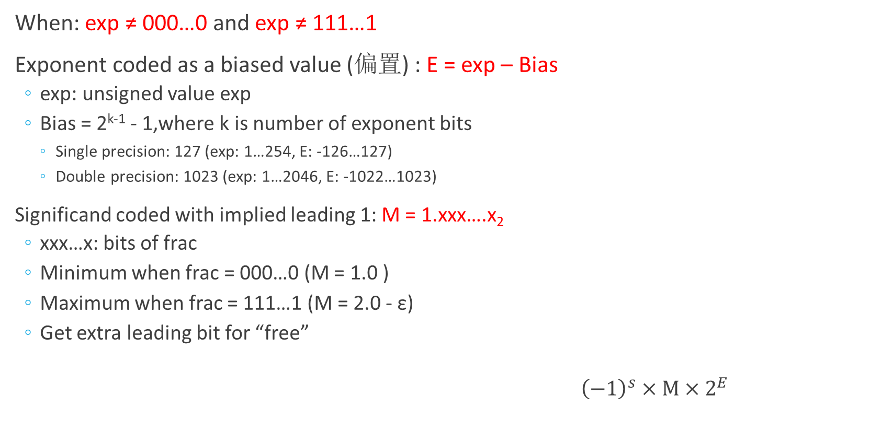
“Normalized” Values
When: exp ≠ 000…0 and exp ≠ 111…1
Exponent coded as a biased value (偏置) : E = exp – Bias
exp: unsigned value exp
Bias = 2^{k‐1} - 1,where k is number of exponent bits
Single precision: 127 (exp: 1…254, E: ‐126…127)
Double precision: 1023 (exp: 1…2046, E: ‐1022…1023)
Significand coded with implied leading 1: M = 1.xxx….x₂
xxx…x: bits of frac
Minimum when frac = 000…0 (M = 1.0 )
Maximum when frac = 111…1 (M = 2.0 - ε)
Get extra leading bit for “free”
${\left(−1\right)}^{s}×M×2^{E}$
Notes:
阶码非全零或全1. 此时阶码被解释为以偏置形式表示的有符号数。
规格化的尾数小数点在最高有效位左边，并且总是1，故尾数值为[1, 2)。但1总被隐去（隐藏位），因此23位尾数表示的实际上是24位有效数字。
通过调整解码，可以很方便的将尾数调整为规格化的表示，即取值在大于等于1，小于2的范围内。

Slide 10
Single Precision Exponent Coding (frame shit)
E (exponent value) | exp (two’s complement) | exp (frame shit)
-126₁₀ | 1000 0010 | 0000 0001
-125₁₀ | 1000 0011 | 0000 0010
. . . . | . . . . | . . . .
-1₁₀ | 1111 1111 | 0111 1110
0₁₀ | 0000 0000 | 0111 1111
1₁₀ | 0000 0001 | 1000 0000
2₁₀ | 0000 0010 | 1000 0001
. . . . | . . . . | . . . .
127₁₀ | 0111 1111 | 1111 1110
阶码采用移码编码，按照无符号数解释时，阶码编码排序与阶码值排序一致，便于阶码比较（对阶）

Slide 11

Normalized Encoding Example
Value: float f = 15213.0
15213₁₀ = 11101101101101₂
= 1.1101101101101₂ × 2¹³
Significand：
M = 1.1101101101101₂
frac = 11011011011010000000000₂
Exponent：
E = 13
bias = 127
exp = 140 = 10001100₂
Result

Slide 12
Normalized Encoding Practice (1)
Value: float f = -0.75
-0.75₁₀ = -0.11₂
= -1.1₂ × 2⁻¹
Sign:
s = 1
Significand：
M = 1.1₂
frac = 1000 0000 0000 0000 0000 000₂
Exponent：
E = -1
bias = 127
Exp = 126 = 0111 1110₂
Result:
1 0111 1110 1000 0000 0000 0000 0000 000 → 0xBF400000

Slide 13
Normalized Encoding Practice (2)
求IEEE 754单精度浮点数0xC0A00000的值是多少？
0xC0A00000 = 1 10000001 0100 0000 0000 0000 0000 000₂
Sign:
s = 1
Significand：
frac = 0100 0000 0000 0000 0000 000₂
M = 1.01₂ = 1.25₁₀
Exponent：
exp = 1000 0001₂ = 129₁₀
bias = 127
E = 129 – 127 = 2
Result:
(-1)¹ × 1.25 × 2² = -5.0

Slide 14
“Denormalized” Values
Condition: exp = 000…0
Exponent value: E = - Bias + 1 (insteads of E = 0 - Bias)
Significand coded with implied leading “0”(Not “1”): M = 0.xxx…x₂
xxx…x: bits of frac
Case: exp = 000…0, frac = 000…0
Represents zero value
Note distinct values: +0 and -0 (why?)
Case: exp = 000…0, frac ≠ 000…0
Numbers closest to 0.0
Equispaced (等间距的)
Notes:
非规格化值有两个用途：表示数值0和非常接近于0的数值
用于处理阶码下溢。当运算结果的阶太小（小于-126）时，尾数右移，阶码加1，如此循环直到尾数为0或阶达到最小值，该过程称为“逐级下溢”

Slide 15
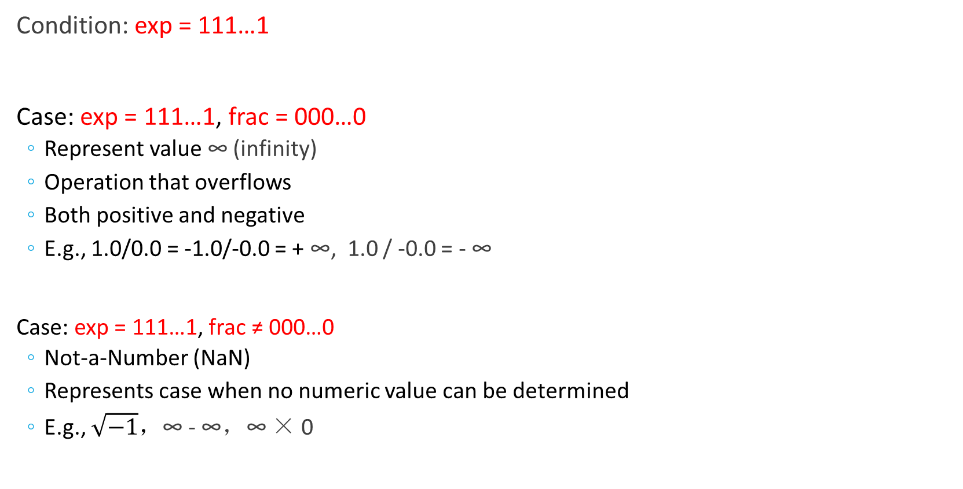
Special Values
Condition: exp = 111…1
Case: exp = 111…1, frac = 000…0
Represent value ∞ (infinity)
Operation that overflows
Both positive and negative
E.g., 1.0/0.0 = -1.0/-0.0 = + ∞, 1.0 / -0.0 = - ∞
Case: exp = 111…1, frac ≠ 000…0
Not-a-Number (NaN)
Represents case when no numeric value can be determined
E.g., $\sqrt{−1}，$∞ - ∞，∞ × 0
Notes:
引入无穷大使得在计算过程中出现异常的情况下程序能继续进行下去。

Slide 16
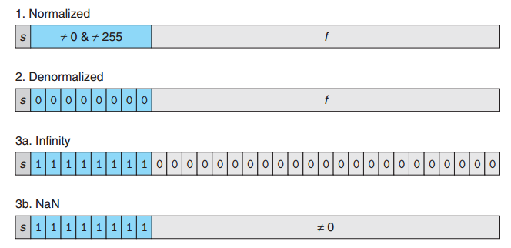
Categories of single-precision floating-point values
Notes:
规格化
非规格化

Slide 17
Visualization: Floating Point Encodings

Slide 18

Tiny Floating Point Example
8-bit Floating Point Representation
The sign bit is in the most significant bit
The next four bits are the exponent, with a bias of 7
The last three bits are the frac
Same general form as IEEE Format
normalized, denormalized
represenation of 0, NaN, infinity

Slide 19
Dynamic Range (Positive Only)
Notes:
8位浮点数的非负值情况
最大非规格化数和最小规格化数之前平滑转变（否则，非规划化数的阶值都是1/128）

Slide 20
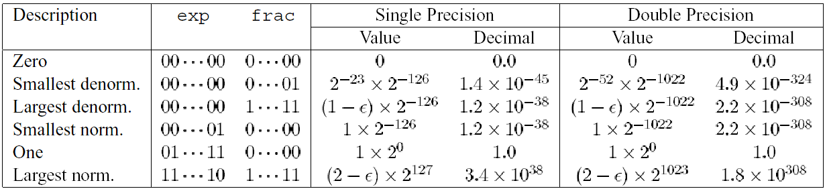
Interesting Numbers
参照该表，请推出最小/最大非规格化负数、最小/最大规格化整数、-1的数值表达式。假设尾数部分位宽为n，阶码位宽为k。（作为本章作业）
Notes:
1. 最小的正非规格化数：最低有效位（尾数最低有效位）为1，其余位均是0。尾数值M=2^{-n}，阶码值E=-2^{k-1}+2。数字值V = 2^{-n-2^(k-1)+2}
2. 最大的正非规格化数：阶码字段均是0，尾数字段全是1。尾数值M=(1-2^{-n})，阶码值E=-2^{k-1}+2。数字值V = (1-2^{-n})*2^{-2^(k-1)+2}
3. 最小的正规格化数：阶码字段最低有效位是1，尾数字段全是0。尾数值M=1，阶码值=-2^{k-1}+2。数字值V = 2^{-2^(k-1)+2}
4. 最大的正规格化数：阶码字段最低有效位是0，其余都是1；尾数字段全1。尾数值M=2-2^{-n}，阶码值 = 2^{k-1}-1。数字值V=(2-2^{-n})*(2^{2^(k-1)-1})

Slide 21
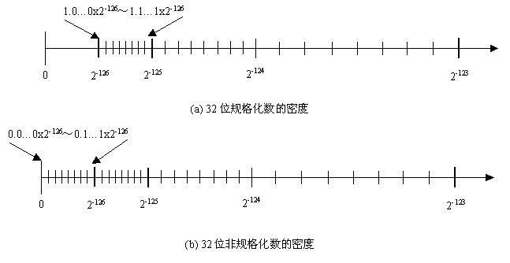
Distribution of values
1.0…0x2⁻¹²⁶~ 1.1…1x2⁻¹²⁶
GAP
0
2⁻¹²⁶
2⁻¹²⁵
2⁻¹²⁴
2⁻¹²³
Normalized numbers
0.0…0x2⁻¹²⁶~ 0.1…1x2⁻¹²⁶
0
2⁻¹²⁶
2⁻¹²⁵
2⁻¹²⁴
2⁻¹²³
Denorms
(-1)^{s}×0.xx…x ×2⁻¹²⁶
Notes:
越靠近原点越稠密

Slide 22
Special Properties of the IEEE Encoding
FP Zero Same as Integer Zero
All bits = 0
Can (Almost) Use Unsigned Integer Comparison
Must first compare sign bits
Must consider -0 = 0
Nans problematic
Will be greater than any other values
Otherwise OK
Denormalized vs. Normalized
Normalized vs. Infinity

Slide 23
Round （舍入）Mode
Mode | 1.40 | 1.60 | 1.50 | 2.50 | -1.50
Round-to-Even | 1 | 2 | 2 | 2 | -2
Round-toward-zero | 1 | 1 | 1 | 2 | -1
Round-down | 1 | 1 | 1 | 2 | -2
Round-up | 2 | 2 | 2 | 3 | -1
Notes:
由于在计算机中浮点数的编码字长有限，因此浮点数的表数范围和精度也都受限，因此浮点数只能近似地表示实数。因此，对于一个实数值，我们希望可以找到一个最接近它的，并可以用浮点形式表示的匹配值，这一过程被称为舍入。对于每一个待舍入的值，根据舍入精度，我们都可以找到它的舍入上界和下界，因此舍入的关键在于舍入方向的确定。IEEE提供了4中输入方法。
Even: 向偶数，最低位为偶数
Zero: 向零方向 （负数向大，正数向小）
Down: 向小的数
Up: 向大的数

Slide 24
Round Mode
Round down:
rounded result is close to but no greater than true result.
Round up:
rounded result is close to but no less than true result.
Round to Zero
rounded result is close to 0.
if positive, round result is no greater than true result
otherwise, no less than true result.
Round to Even (Default Rounding Mode)
half-way may be round up or round down
the least significant digit of rounded result (half-way) must be even
others are rounded to the nearest bound
Notes:
浮点数的表示方法限制了浮点数的范围和精度，所以浮点运算只能近似地表示实数运算。对于值x，我们希望找到能够用确定浮点格式表示的、最接近的比配值x’，这就是所谓的舍入。
问题的关键是舍入的方向。

Slide 25
Round-to-Even
Applying to Other Decimal Places
When exactly halfway between two possible values
Round so that least significant digit is even
E.g., round to nearest hundredth
1.2349999 1.23 (Less than half way)
1.2350001 1.24 (Greater than half way)
1.2350000 1.24 (Half way—round up)
1.2450000 1.24 (Half way—round down)

Slide 26
Rounding Binary Number
“Even” when least significant bit is 0
Half way when bits to right of rounding position = 100…₂
Value | Binary | Rounded | Action | Round Decimal
2 3/32 | 10.00011 | 10.00 | Down | 2
2 3/16 | 10.0011 | 10.01 | Up | 2 1/4
2 7/8 | 10.111 | 11.00 | Up | 3
2 5/8 | 10.101 | 10.10 | Down | 2 1/2
Notes:
舍入到百分位

Slide 27
Round Practice
根据舍入到偶数规则，给出如下二进制小数舍入到小数点右边1位（ 1/2 位）。
A. 10.010
B. 10.011
C. 10.110
D. 11.001
10.0（正中间）
10.1
11.0（正中间）
11.0

Slide 28
Floating Point Operations: Basic Idea
Basic idea
First compute exact result
Make it fit into desired precision
Possibly overflow if exponent to large
Possibly round to fit into frac

Slide 29
Floating Point Multiplication
(-1)^{s1} M1 2^{E1} × (-1)^{s2} M2 2^{E2} （参与运算的两个浮点数均是规格化浮点数）
Exact Result: (-1)^{s} M 2E
Sign s: s1^s2
Significand M: M1 ×M2
Exponent E: E1 + E2
Fixing（规格化）
If M ≥ 2, shift M right, increment E
If E out of range, overflow
Round M to fit frac precision
Implementation
Biggest chore（繁琐） is multiplying significands

Slide 30
Floating Point Addition
(-1)^{s1} M1 2^{E1} + (-1)^{s2} M2 2^{E2}
Assume E1 > E2
Exact Result: (-1)^{s1} M 2E
Sign s, Significand M : Result of signed align & add
Exponent E: E1（尾数右移，小阶向大阶对齐）
Fixing（规格化）
If M ≥ 2, shift M right, increment E（右规，尾数只需右移1次）
If M < 1, shift M left k positions, decrement E by k（左规）
Overflow if E out of range
Round M to fit frac precision

Slide 31
Floating Point Addition Example
例：用二进制浮点数形式计算 0.5 +(– 0.4375) =？
0.4375=0.25+0.125+0.0625=0.0111B
解：0.5 = 1.000 x 2⁻¹， - 0.4375 = -1.110 x 2⁻²
对 阶: -1.110 x 2⁻² → -0.111 x 2⁻¹
加 减: 1.000 x 2⁻¹ +( -0.111 x 2⁻¹ ) = 0.001 x 2⁻¹
左 规: 0.001 x 2⁻¹ → 1.000 x 2^{–4}
判溢出: 无
结果为： 1.000 x 2^{–4} = 0.0001000 = 1/16 = 0.0625

Slide 32
Floating Point in C
C Guarantees Two Levels
float single precision
double double precision
Conversions/Casting
Casting between int, float and double changes bit representation
double/float → int
Truncates fractional part
Like rounding toward zero
Not defined when out of range
int → double
Exact conversion, as long as int has ≤ 53 bit word size
int → float
Will round according to rounding mode

Slide 33
Floating Point in C
int x = …;
float f = …;
double d = …;
Assume neither d nor f is NaN or infinity

Slide 34
Floating Point in C
x == (int)(float) x No: 24 bit significand
x == (int)(double) x Yes: 53 bit significand
f == (float)(double) f Yes: increases precision
d == (float) d No: loses precision
f == -(-f); Yes: Just change sign bit
2/3 == 2/3.0 No: 2/3 == 0
d < 0.0 ⇒ ((d*2) < 0.0) Yes!
d *d >= 0.0 Yes!
(d+f)-d == f d = 1.0*230，f = 1.0，对阶后f = 0

Slide 35
Example: Ariana Rocket Explode
1996年6月4日，Ariana 5火箭初次航行，在发射仅仅37秒钟后，偏离了飞行路线，然后解体爆炸，火箭上载有价值5亿美元的通信卫星。
原因是在将一个64位浮点数转换为16位带符号整数时，产生了溢出异常。溢出的值是火箭的水平速率，这比原来的Ariana 4火箭所能达到的速率高出了5倍。在设计Ariana 4火箭软件时，设计者确认水平速率决不会超出一个16位的整数，但在设计Ariana 5时，他们没有重新检查这部分，而是直接使用了原来的设计。
在不同数据类型之间转换时，往往隐藏着一些不容易被察觉的错误，这种错误有时会带来重大损失，因此，编程时要非常小心。

Slide 36

Questions
Why ?
$\text{0.1 + 0.1 + 0.1 + 0.1 + 0.1 + 0.1 + 0.1 + 0.1 + 0.1+ 0.1 }≠$ 1
$\text{0.2 + 0.2 + 0.2 + 0.2 + 0.2 = 1}$
Accuracy & Precision

Slide 37
Homework & Lab
作业：
已上传至智慧树，请电子版提交，截止时间：10月9日晚23:59
实验：
已上传至智慧树，按实验指导书要求提交，截止时间：10月9日晚23:59
实验1分为两部分，先布置第一部分。

